Slide 1
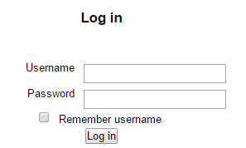
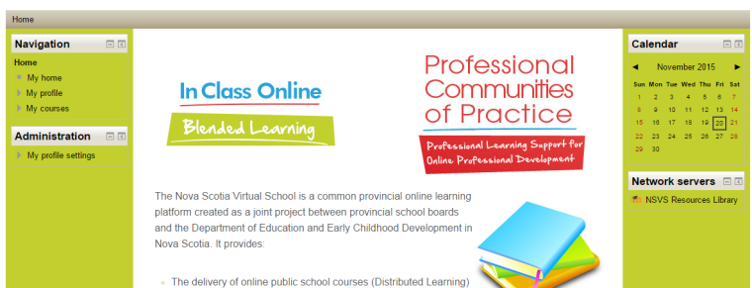
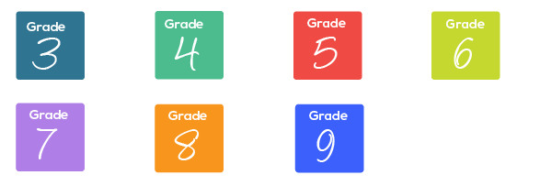
Go to google.ca
Search “HRSB moodle”
Click here
Then
Then
Then
username@gnspes.ca
8thgr17

